Slide 1
Ai Project presentation

Slide 2
Agenda
Topic:
Explanation of AI concept used
Research Evidences
Reason for Selection of topic
Solution:
Explanation of the solution and developed application
Achieved results
How it solves real world problems?
Synthesis of Information:
Pseudo Code for the solution
Diagrammatical representations of the solution

Slide 3

TOpics

Slide 4

Ai concepts used
Random Forest regression
Deep Q Learning
Genetic algorithms

Slide 5
Random Forest Regression
The foundation of the project relies on Supervised Learning to predict route lengths.
How it works: A Random Forest acts like a "committee" of many Decision Trees. Instead of relying on one path, it averages the predictions of 100 different trees to ensure high accuracy and prevent errors.
Key Insight: The model identified "Vertices" (the number of coordinate points in a route) as the most important factor in determining distance.
Achieved Result: This model reached an $R^{2}$ Score of 0.9638, meaning it is over 96% accurate in its predictions.

Slide 6
Genetic Algorithm
To find the most efficient travel paths, the system uses a Genetic Algorithm, which is a search technique inspired by Charles Darwin’s theory of natural evolution.
The Process: The algorithm starts with a "population" of random routes and "evolves" them over 50 generations. It sorts routes by efficiency—where shorter is better—and keeps the "fittest" winners to create the next generation.
Outcome: Through crossover and mutation, the system successfully optimized path efficiency to a score of 0.94, identifying shorter connections that were not immediately obvious.

Slide 7
Deep Q-Learning
For handling dynamic, real-time changes in the bus network, the project employs Deep Q-Learning (DQN).
How it works: Unlike the other models, DQN learns through trial and error. An AI "agent" explores the transit network and receives "rewards" for making efficient decisions and "penalties" for mistakes.
Learning Progress: Over 50 episodes, the agent's rewards rose steadily from -100 toward 0. This proves the AI successfully learned to navigate the complex environment with fewer errors over time.

Slide 8
Reason for the selection of the topic
The main reason is due to my personal experience of struggle while commuting through a public transportation

Slide 9
Solutions

Slide 10

Explanation of the solution and developed application
How it Works
Data Preprocessing: The system loads a cleaned_routes.csv dataset. It uses LabelEncoder to convert categorical text (like route names) into numerical formats, preventing system errors during training.
Predictive Modeling: A Random Forest Regressor analyzes route "Vertices" to predict distance with high precision.
Path Evolution: The Genetic Algorithm builds a calculation graph and runs through 50 generations to identify the "fittest" (shortest) routes.
Adaptive Routing: The DQN agent simulates 50 episodes of learning, improving its cumulative reward as it masters the transit environment.

Slide 11
Explanation of the solution and developed application
Achieved Results
High Accuracy: The Random Forest model achieved a stellar R2 Score of 0.9638, significantly outperforming Linear and Decision Tree regressions.
Optimization Success: The Genetic Algorithm successfully optimized path efficiency to a score of 0.94.
Learning Progress: The DQN agent demonstrated consistent improvement, moving from a reward of -100 to nearly -20, proving its ability to adapt to network changes.

Slide 12
Explanation of the solution and developed application
How the solution Addresses Real World Problems
There are many solutions which are addressed in this project some of them are as follows:
• Reduces confusion for public transport users
• Saves travel time and effort
• Helps students, tourists and new personal in the area
• Improves accessibility to transportation information
• Promotes Efficient use of public transportation

Slide 13
Synthesis of information

Slide 14
Pseudo code for genetic algorithm
Input: Set of routes R
Output: Optimal route R*
Initialize population P with random routes
Set generation = 0
While generation < MAX_GENERATIONS:
For each route r in P:
Compute fitness[r]
Select best routes from P as parents
Generate new routes using crossover
Apply mutation to new routes
Replace population P with new routes
generation = generation + 1
Select route R* with best fitness
Return optimal route R*

Slide 15
Pseudo code for random forest regression
Input: Training data D, route features X
Output: Predicted travel time T
Initialize empty forest F
For i = 1 to NUMBER_OF_TREES:
Create bootstrap sample Di from D
Train decision tree Ti using Di
Add Ti to forest F
For each input route x:
For each tree Ti in F:
Predict travel time ti
Compute average prediction:
T = mean(t1, t2, ..., tn)
Return predicted travel time T

Slide 16
Pseudo code for Deep Q-learning
Input: Source S, Destination D
Output: Learned optimal route policy
For each route r in R:
Initialize Q-network with random weights
Initialize replay memory M
For episode = 1 to MAX_EPISODES:
Set current state = S
While current state is not D:
Select action using ε-greedy policy
Execute action and move to next state
Receive reward
Store (state, action, reward, next state) in M
Sample batch from M
Update Q-network using sampled data
Set state = next state
Return trained Q-network

Slide 17
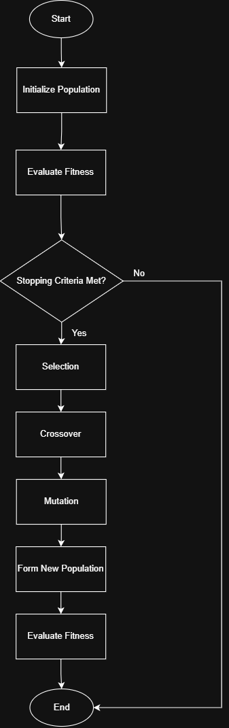
Flowchart for genetic algorithms

Slide 18
Navigating Q&A sessions
Know your material in advance​
Anticipate common questions​
Rehearse your responses
Maintaining composure during the Q&A session is essential for projecting confidence and authority. Consider the following tips for staying composed:​
Stay calm​
Actively listen​
Pause and reflect​
Maintain eye contact

Slide 19
Flowchart for genetic algorithms

Slide 20
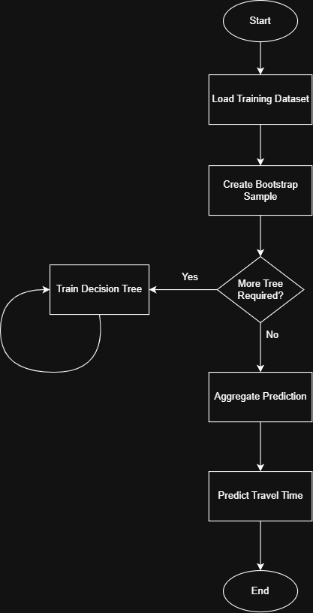
Flowchart for random forest regression

Slide 21
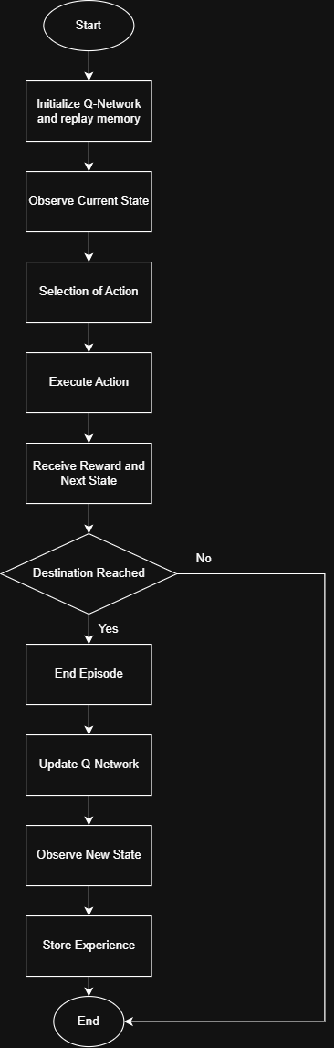
Flowchart for Deep q-learning

Slide 22
THANK YOU
Rijan Gubhaju​
rijan.gubhaju5710@gmail.com

